Slide 1
VenturePilot AI
AI-Powered Startup Blueprint Generator
“Transforming startup ideas into actionable business blueprints using IBM
watsonx AI and Granite Foundation Models”

Slide 2

Project Tile – VenturePilot AI – AI-Powered Startup Blueprint Generator
Domain of Project – Entrepreneurship / Business Planning
Student Name | Recent Passport Photo | Email ID | Mobile number [WhatsApp]
SUBITSHA N |  | Subitsha04@gmail.com

Slide 3
Problem Statement -
Problem Statement - Startup Blueprint Generator Agent
The Challenge – A Startup Blueprint Generator Agent, powered by RAG (Retrieval-Augmented Generation), transforms raw startup ideas into complete, actionable business blueprints. It retrieves relevant data on market research, funding options, competitor analysis, revenue models, government schemes, and legal requirements from startup portals, incubator databases, and policy documents. Users can describe their idea in simple terms, and the agent provides a structured plan including business model canvas, estimated budget, go-to-market strategy, and potential investor connections. The agent eliminates ambiguity and accelerates the journey from idea to implementation. This AI-driven assistant empowers aspiring entrepreneurs with clarity, resources, and direction to launch their ventures successfully.
re often expensive and time-consuming, making them inaccessible for students, early-stage entrepreneurs, and small businesses.

Slide 4
The Objective
Develop an AI-powered web application that assists entrepreneurs in generating professional startup blueprints using Artificial Intelligence.
The system should:
Generate structured startup blueprints from user input.
Provide business strategy recommendations.
Perform SWOT analysis.
Suggest funding opportunities and budget estimation.
Generate competitor analysis.
Create go-to-market strategies.
Produce a six-month implementation roadmap.

Slide 5
Proposed Solution -
Overview
To address the challenges faced by aspiring entrepreneurs, VenturePilot AI is proposed as an AI-Powered Startup Blueprint Agent. The solution combines a user-friendly Flask web application with IBM watsonx AI and Granite Foundation Models to generate structured and personalized startup blueprints.
The AI agent analyzes the information provided by the user, applies prompt engineering techniques, and generates business recommendations covering strategy, financial planning, market positioning, and implementation.
Key Capabilities
Generate comprehensive startup blueprints from user input.
Produce executive summaries and business model recommendations.
Perform SWOT and competitor analysis.
Estimate startup budget and funding requirements.
Recommend revenue models and go-to-market strategies.
Create a six-month implementation roadmap.
Deliver AI-powered guidance through an interactive web application.

Slide 6
Expected Benefits
Reduces the time required for startup planning.
Assists entrepreneurs with data-driven business recommendations.
Improves the quality and structure of business plans.
Makes business consulting accessible to students and first-time entrepreneurs.
Encourages innovation through AI-assisted decision-making.

Slide 7
Technology Used
Technology / Tool Python 3.11 - Core programming language used for backend development
Flask - Web framework for developing the application HTML5, CSS3, JavaScript - Designing and building the user interface IBM watsonx AI - AI platform used to access Granite Foundation Models IBM Granite Foundation Model - Generates AI-powered startup blueprints and business recommendations IBM Bob - AI-assisted development and application building Git & GitHub - Version control and source code management Render - Cloud platform used to deploy the web application

Slide 8
AI Agent Workflow -
Workflow Description
The VenturePilot AI system follows a simple and intelligent workflow:
The user registers or logs into the application.
The user enters startup details through the startup information form.
Flask validates and processes the user input.
The backend constructs a structured prompt.
The prompt is sent to IBM watsonx AI.
IBM Granite analyzes the request and generates a startup blueprint.
The generated blueprint is displayed to the user through the web
interface.

Slide 9















AI Agent Workflow -
User
Login/Register
Startup Information
Flask Backend
Prompt Engineering
IBM watsonx
AI (Granite Foundation)
Startup Blueprint
Display Results

Slide 10
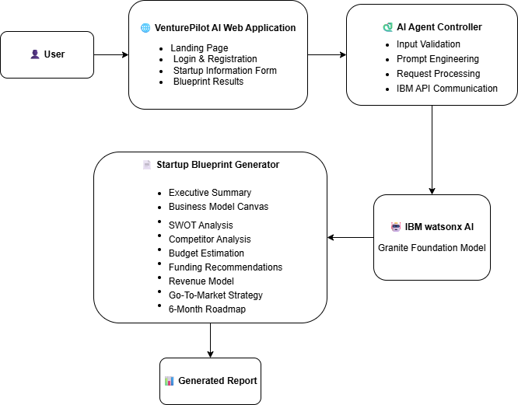
Architecture blueprint

Slide 11
Key Features of VenturePilot AI
AI-Powered Startup Blueprint
Generates a comprehensive startup blueprint using IBM Granite Foundation Model.
Business Model Canvas
Provides a structured business model for the startup idea.
SWOT Analysis
Identifies Strengths, Weaknesses, Opportunities, and Threats.
Budget & Funding Recommendations
Estimates initial budget and suggests funding options.
Go-To-Market Strategy
Provides marketing and customer acquisition strategies.
Six-Month Roadmap
Generates a step-by-step implementation plan.
Secure User Authentication
Supports user registration and login.
Web-Based Application
Accessible through any modern web browser.

Slide 12
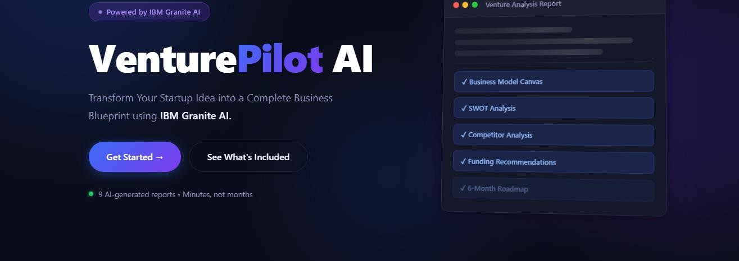
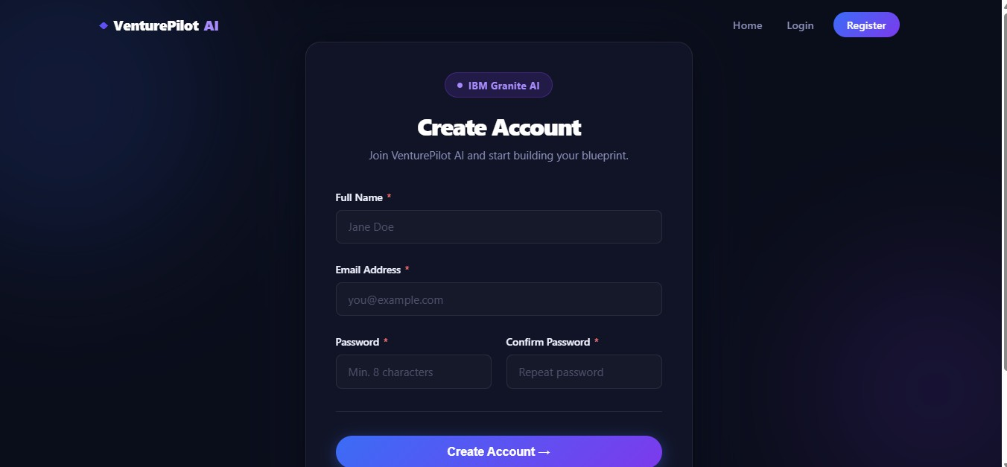
Screenshots
VenturePilot AI Home Page
·
·
·
User Registration Interface

Slide 13
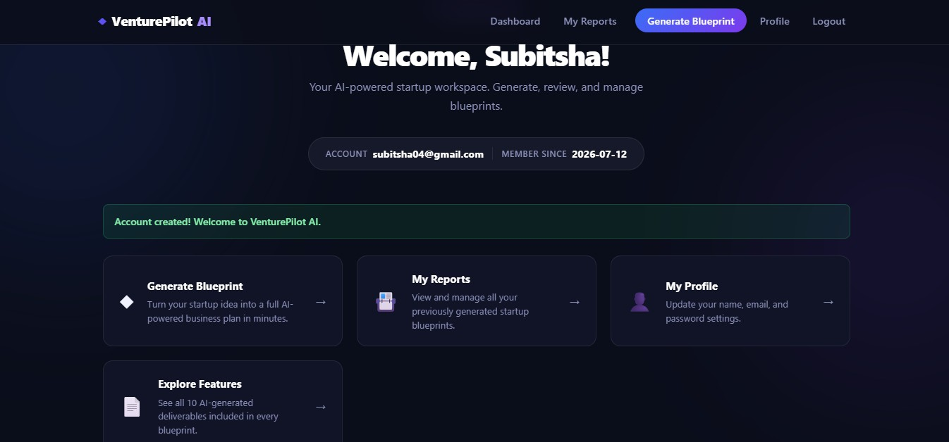
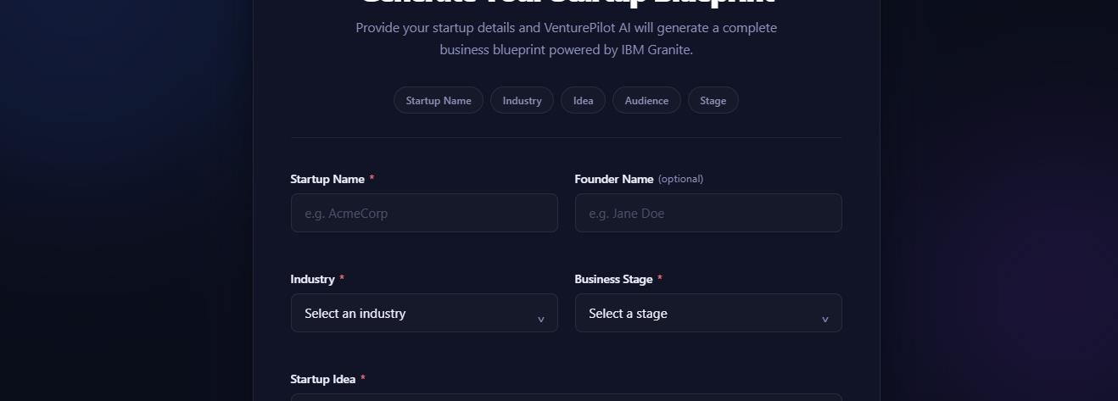
Screenshots
User Dashboard
·
·
·
Startup Information Form

Slide 14
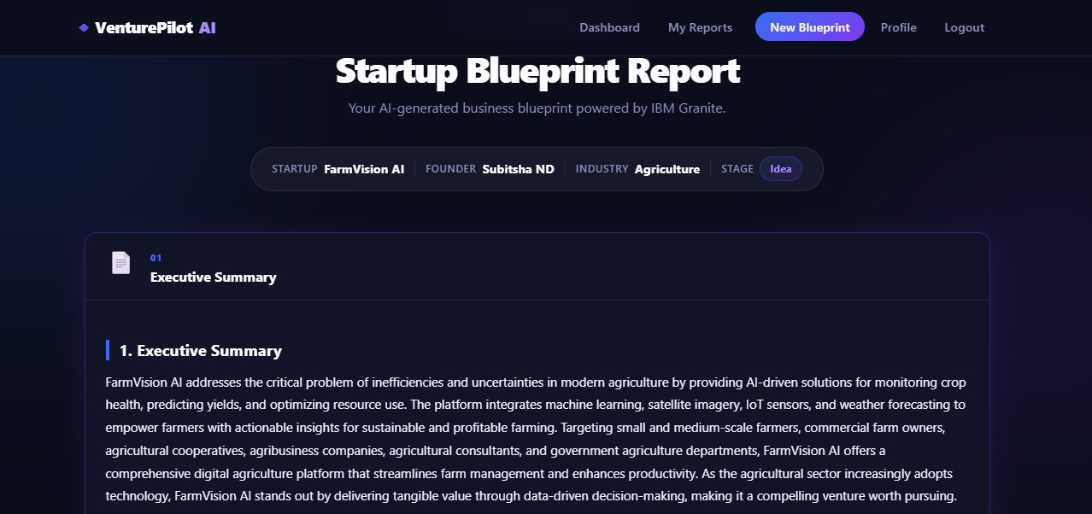
Screenshots
·
·
·
AI-Generated Startup Blueprint

Slide 15
Deployment
Render Cloud Platform
VenturePilo t AI Web Application
IBM
watsonx AI (Granite Model)
AI
Generated Startup Blueprint
Source Code GitHub
Live Demo
https://venturepilot-ai.onrender.com

Slide 16
Git Hub Link
https://github.com/subitshaND/venturepilot-ai.git
·
·
·

Slide 17
Challenges Faced & Solutions
Challenges Faced
Integrating IBM watsonx AI with the Flask application.
Optimizing prompts for accurate startup blueprints.
Resolving deployment and dependency issues on Render.
Securing API keys using environment variables.
Solutions
·
Configured IBM watsonx AI SDK and API credentials correctly.
Improved prompt engineering for better AI responses.
·• Updated requirements.txt and used Python 3.11.
Successfully deployed the application on Render with secure environment variables.
·

Slide 18
Future Scope
Multi-language Support – Enable users to generate startup blueprints in multiple languages.
Financial Forecasting – Add AI-powered revenue and expense predictions.
Market Trend Analysis – Integrate real-time market insights for better
· business decisions.
Mobile Application – Develop Android and iOS versions for easier accessibility.
·
Investor Pitch Deck Generation – Automatically create professional pitch presentations.
·
Team Collaboration – Allow multiple users to collaborate on the same startup
project.

Slide 19
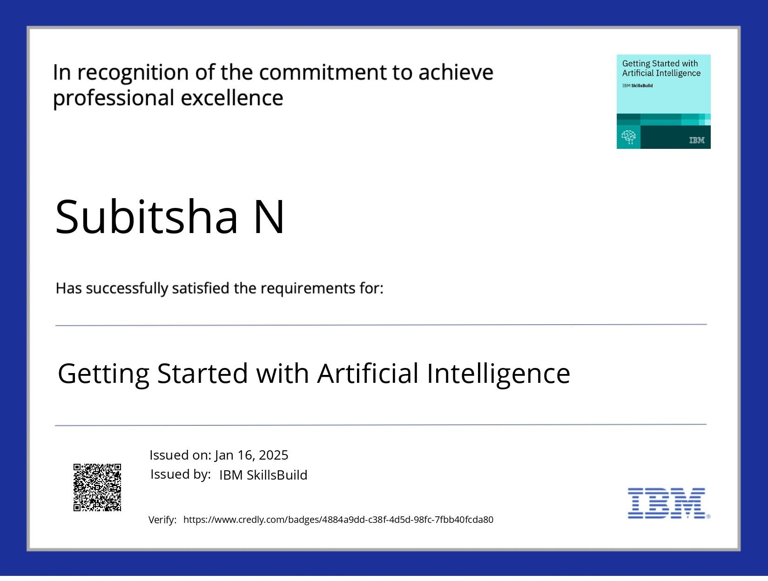
Getting Started With Artificial Intelligence

Slide 20
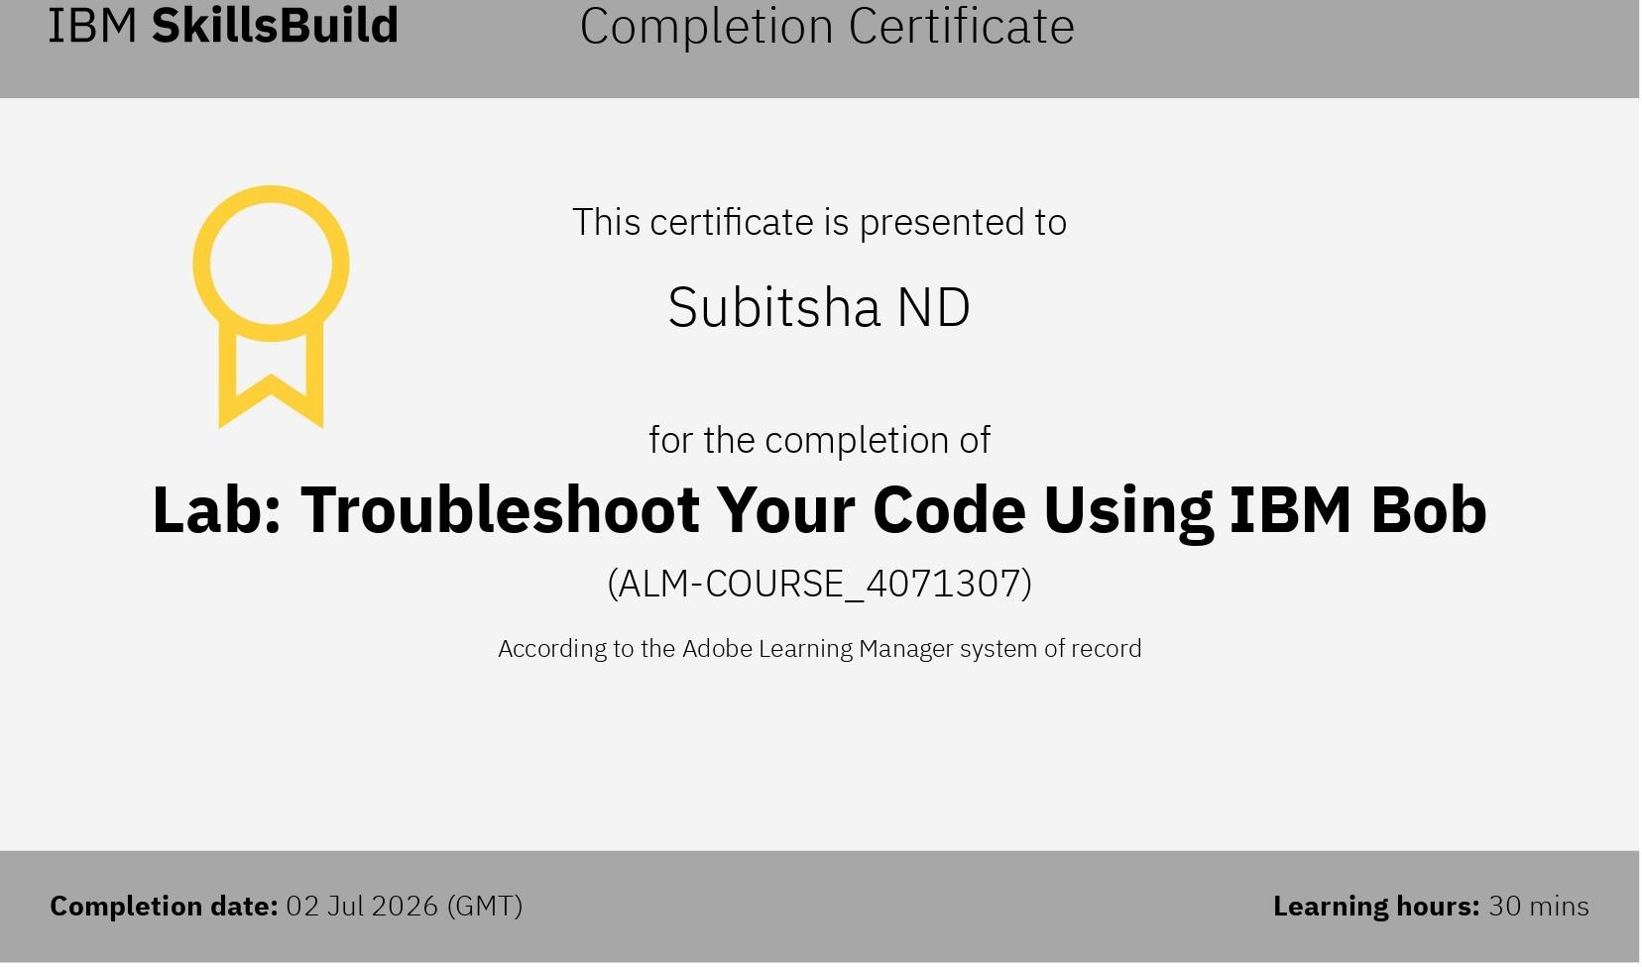
IBM BOB Certificate

Slide 21
Thank You!

